Slide 1
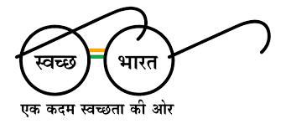

eGramPanchayat

Slide 2
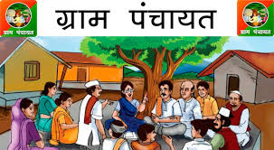
Problems faced by traditional System
In villages,All records of villagers are managed by Gram Panchayat of respective village.There is no integrated system for data management and storage.Its too annoying and difficult to manage records.Also there is less interaction between villager and Gram Panchayat. During this corona pandemic, situation has become worst. So we are developing an integrated web system for Gram Panchayat.

Slide 3
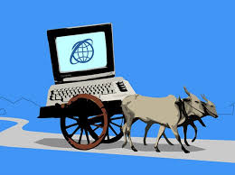
Our Solutions
Villagers are able to pay revenue taxes of Home, Water, Elecrticity and Farm online.
Villager will get receipt of transaction as a proof.
Gram Panchayat will provide Resedential certificate and other documents in PDF format on Villager's email.
Latest schemes of government for villager's development will be floated on website.Villagers will get information about scheme on site.
Monthly notifications regarding bill payments will be sent to the villagers.

Slide 4
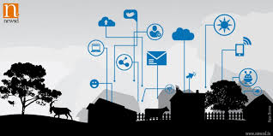
Layout
Home Page :
This will contain Basic info about village , its different amenities , programmes and schemes currently ran by govt.
Schemes :
Display Schemes (Both Centre and States)
Admin Page :
Display Dashboard for Admin
Verify information about new users
Generate bills for User
Send Notifications to users
Add new Schemes to Schemes Tab

Slide 5

Layout (continued)
User Login and Bill Payment:
Register as new user
Update or Change Personal Details
Check for pending bills
Pay bills
Documents:
Here user can issue residence certificates , other similar important documents.
About the Village:
Contain the information about village.
Display Contact details of Gram Panchayat , Sarpanch etc.
Display Location on google Maps

Slide 6

Stake Holders
Villagers
Government Officials
Government
Village Council - Gram Panchayat

Slide 7
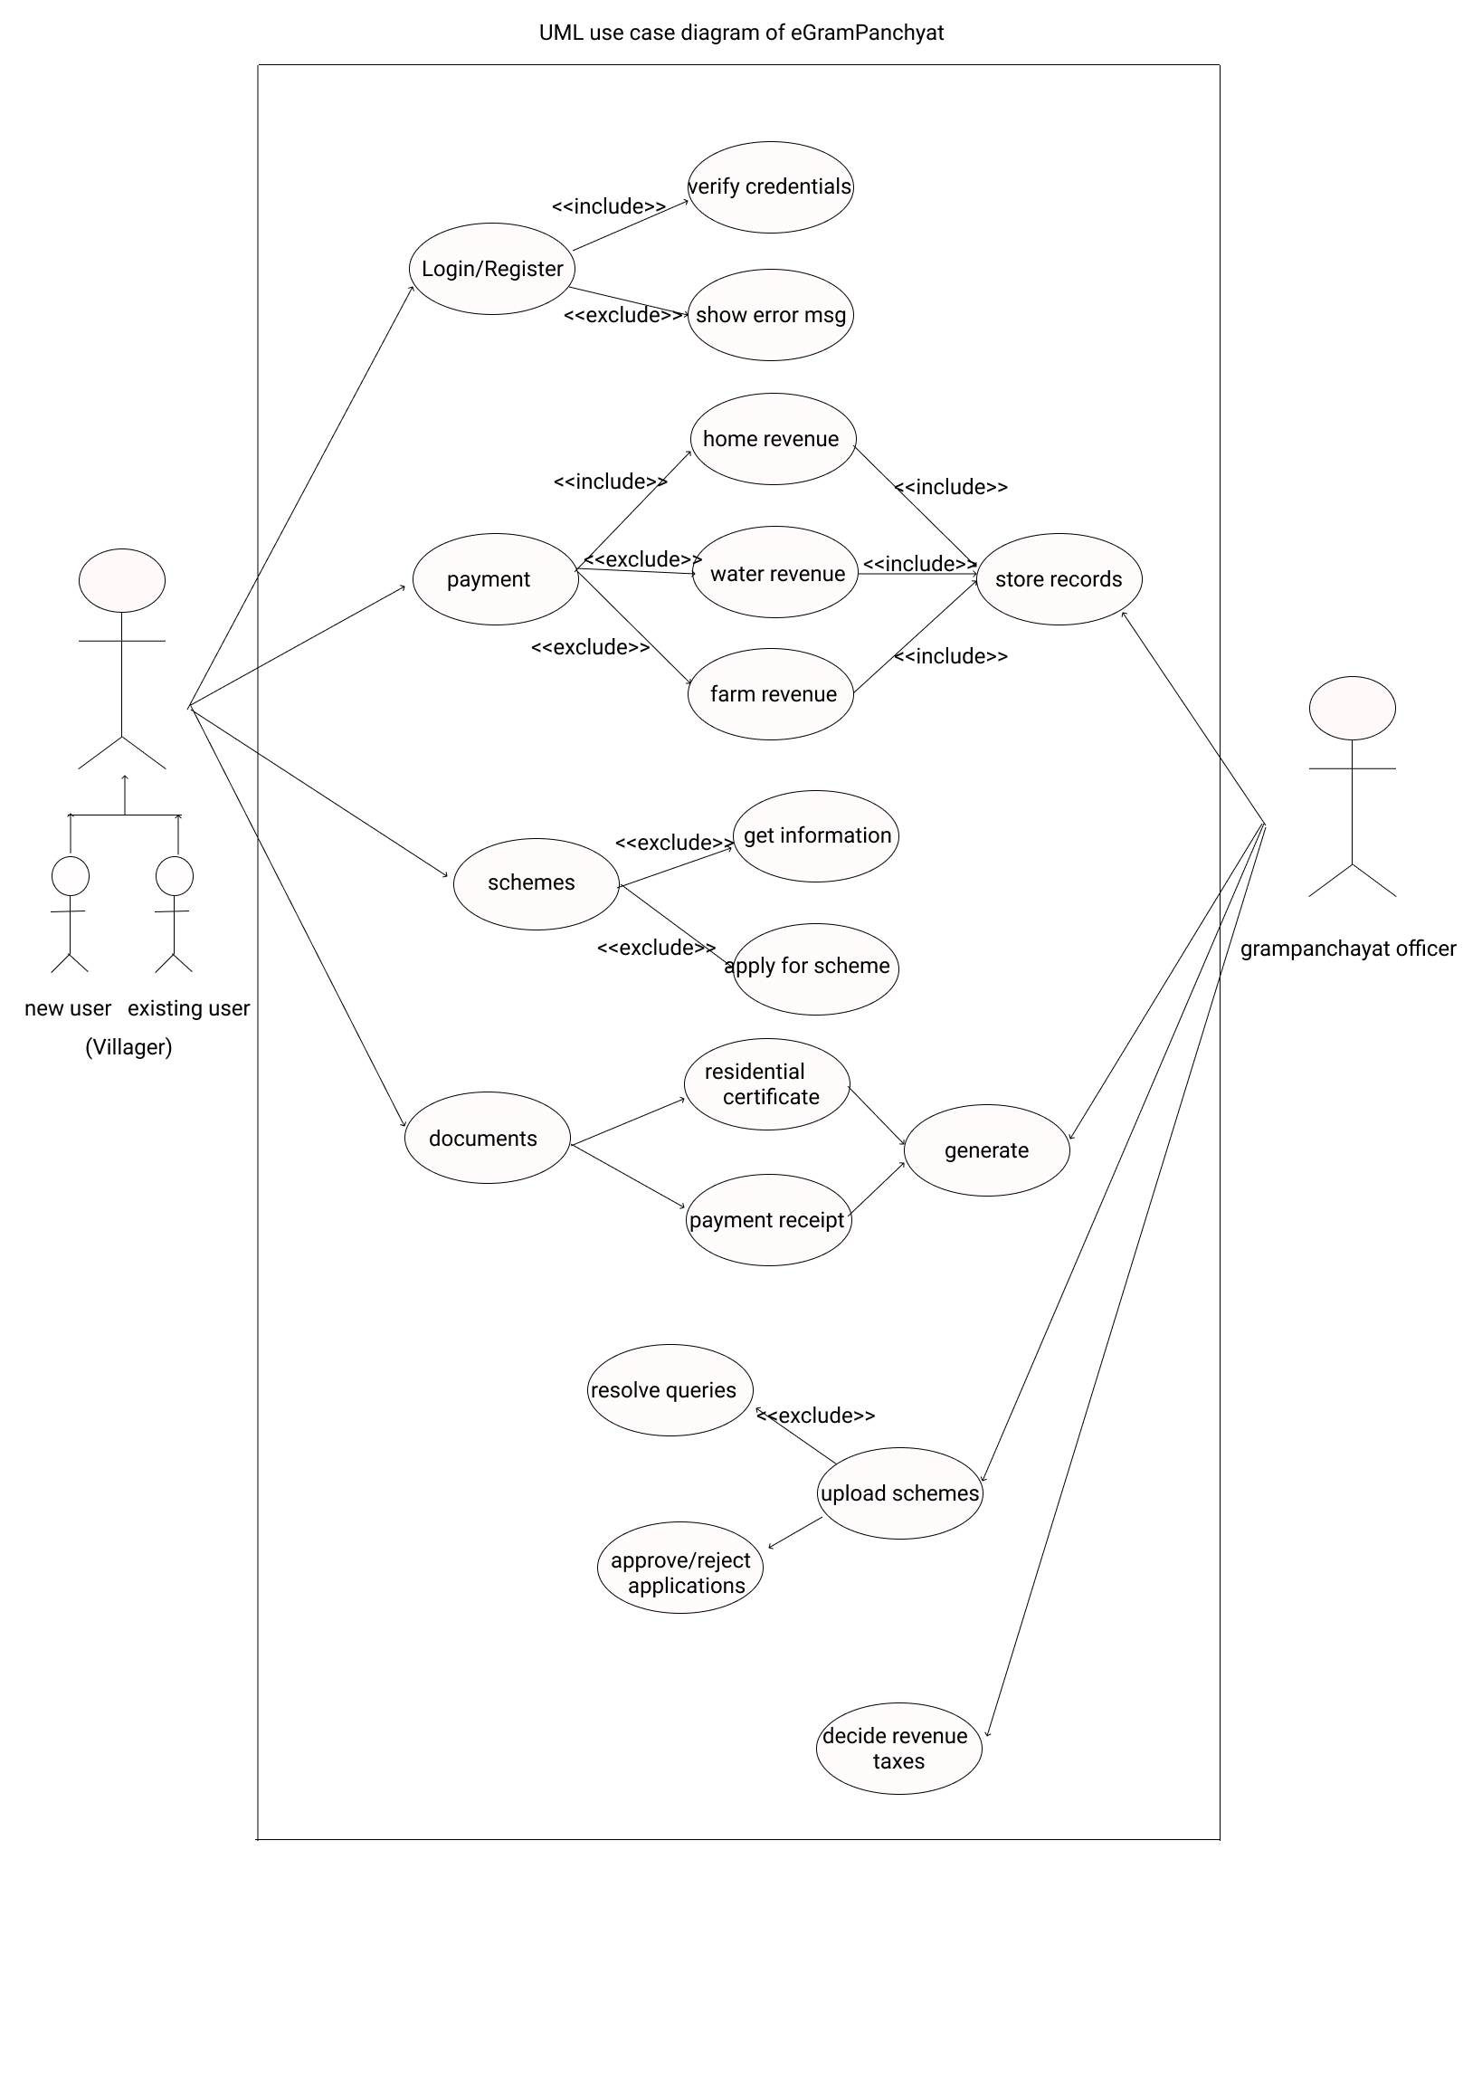
UML Use-case

Slide 8
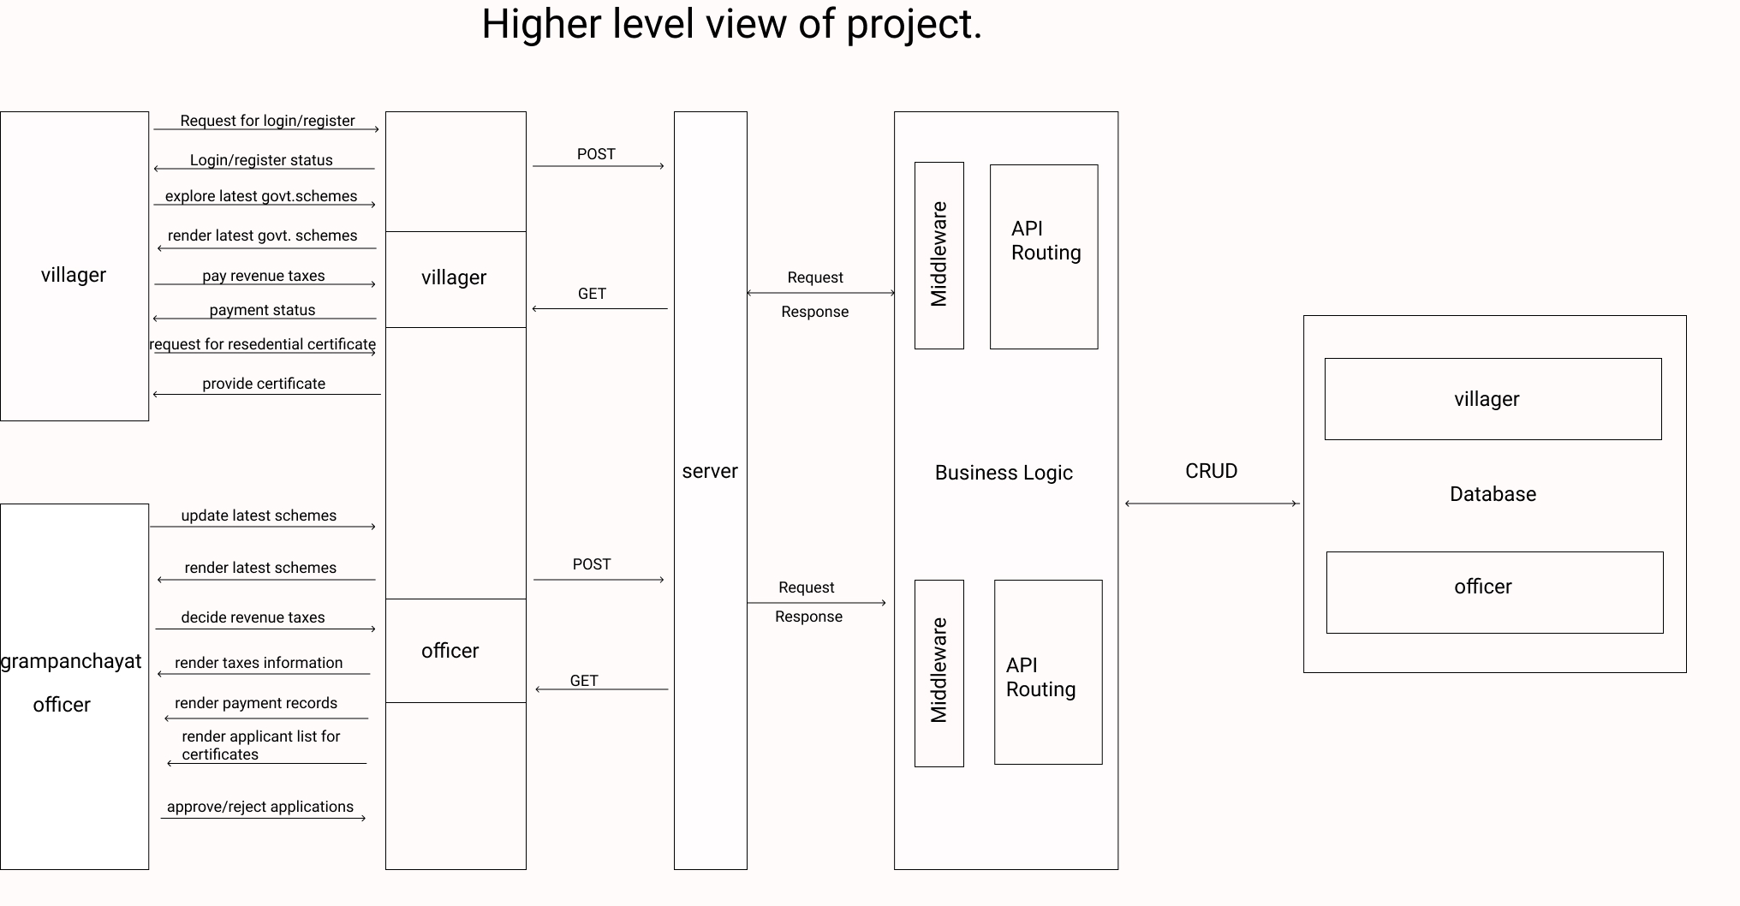

Slide 9
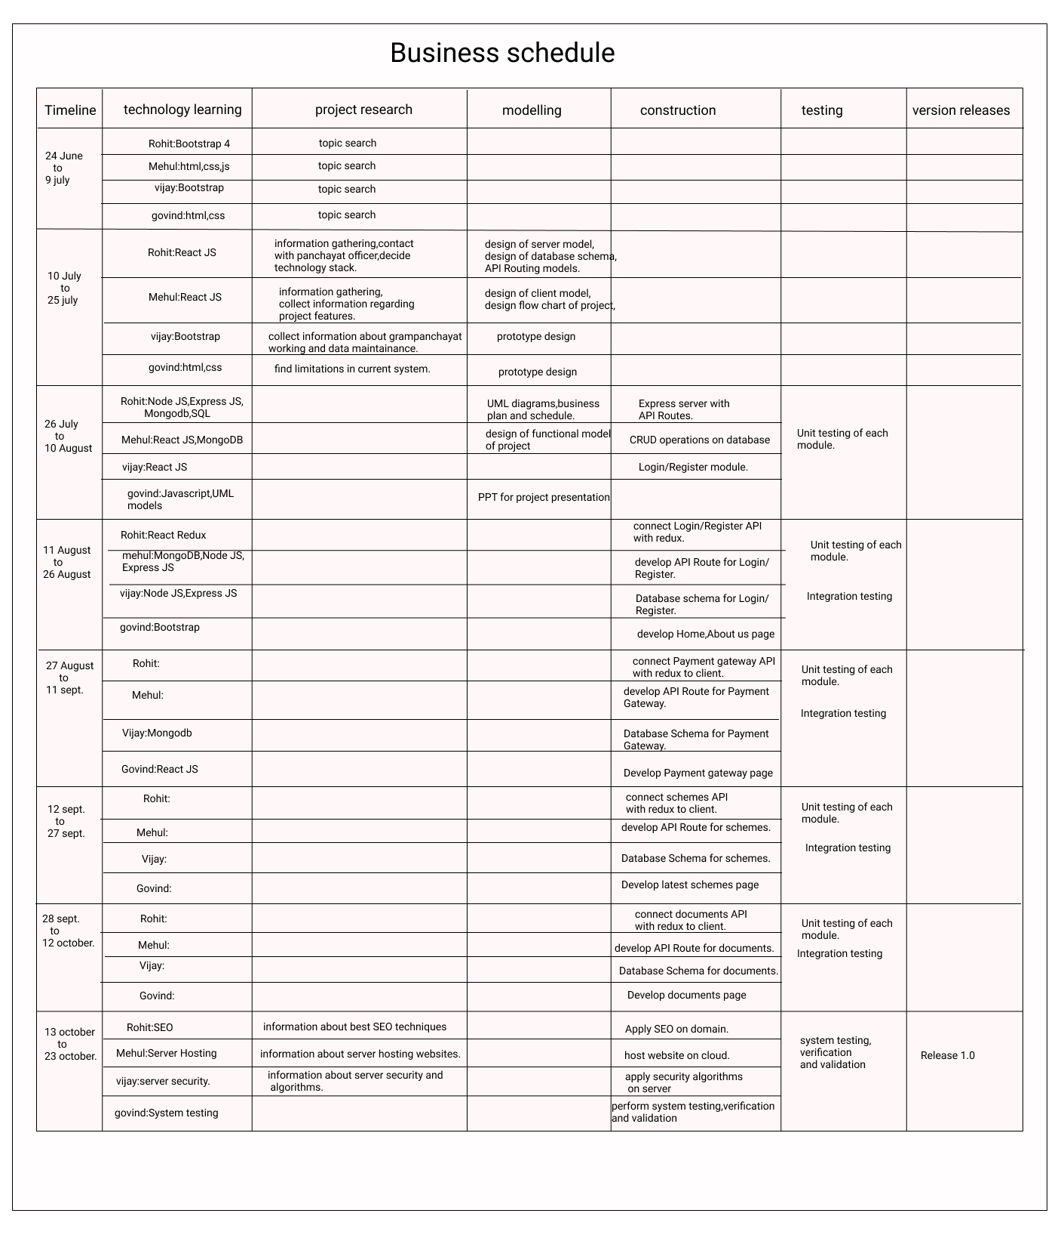
Project Plan:

Slide 10
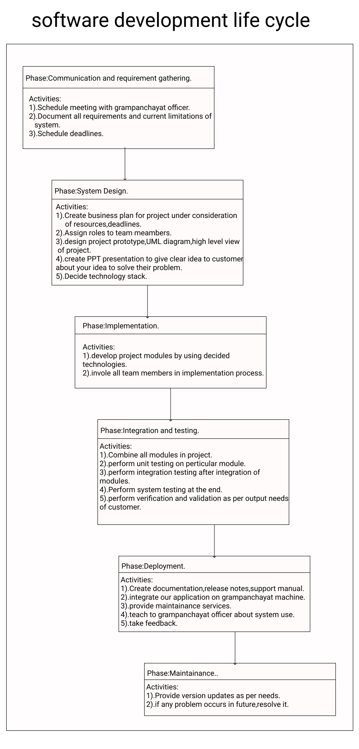

Slide 11
JIRA
JIRA lets you prioritize, assign, track, report and audit your ‘issues’, from software bugs and helpdesk tickets to project tasks and change requests
JIRA improves productivity by cutting down on time wasted on tracking issues and coordination
JIRA improves quality by ensuring all tasks are recorded down with all the details and followed up till completion

Slide 12
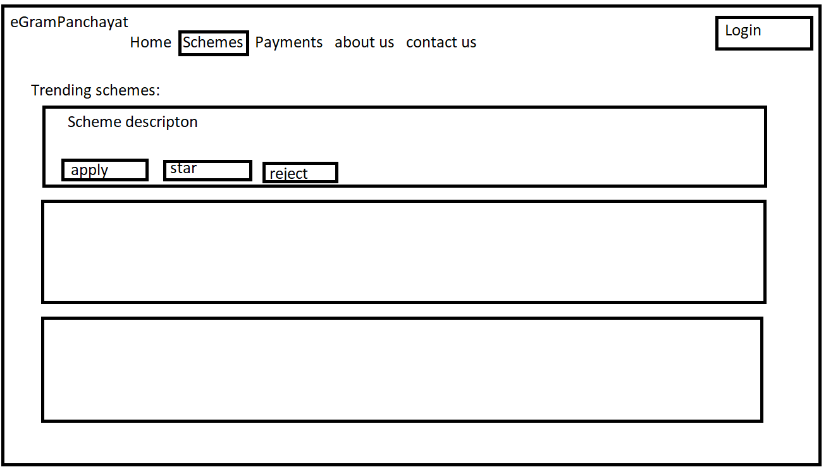
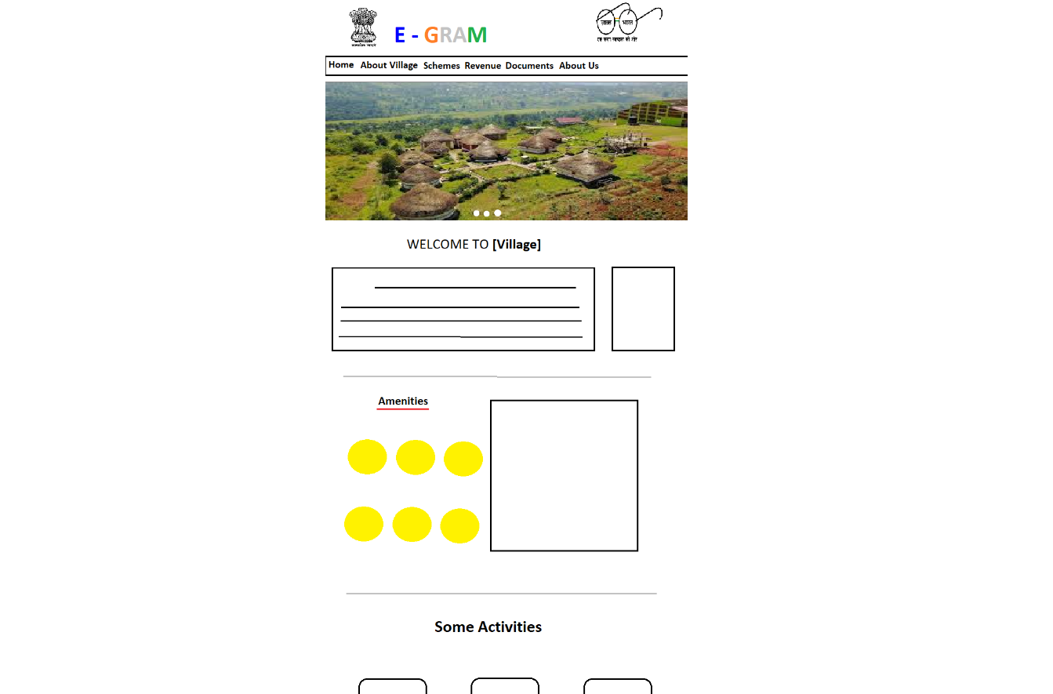
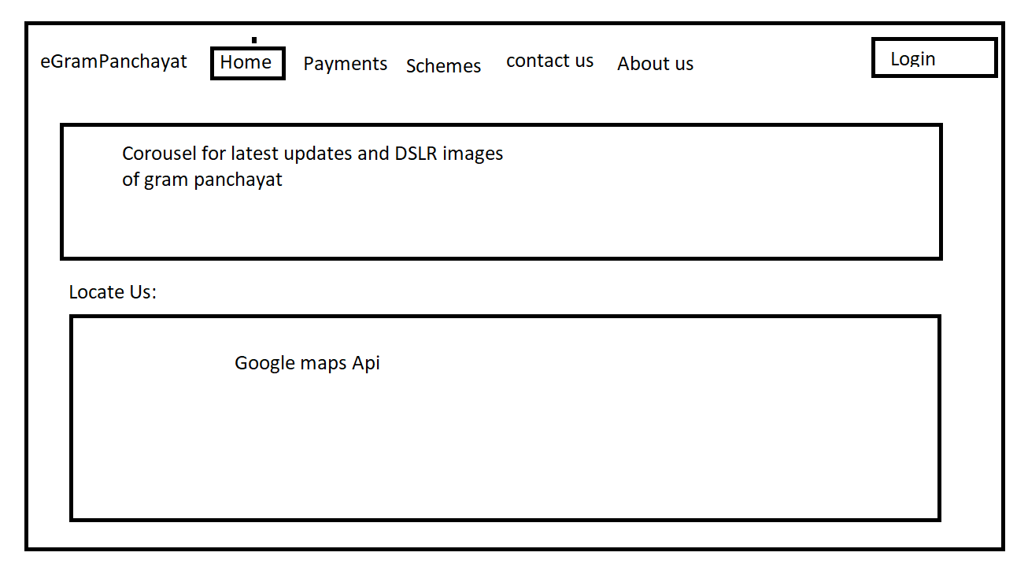
Designs
Sketched rough designs for clear understanding of out product.

Slide 13
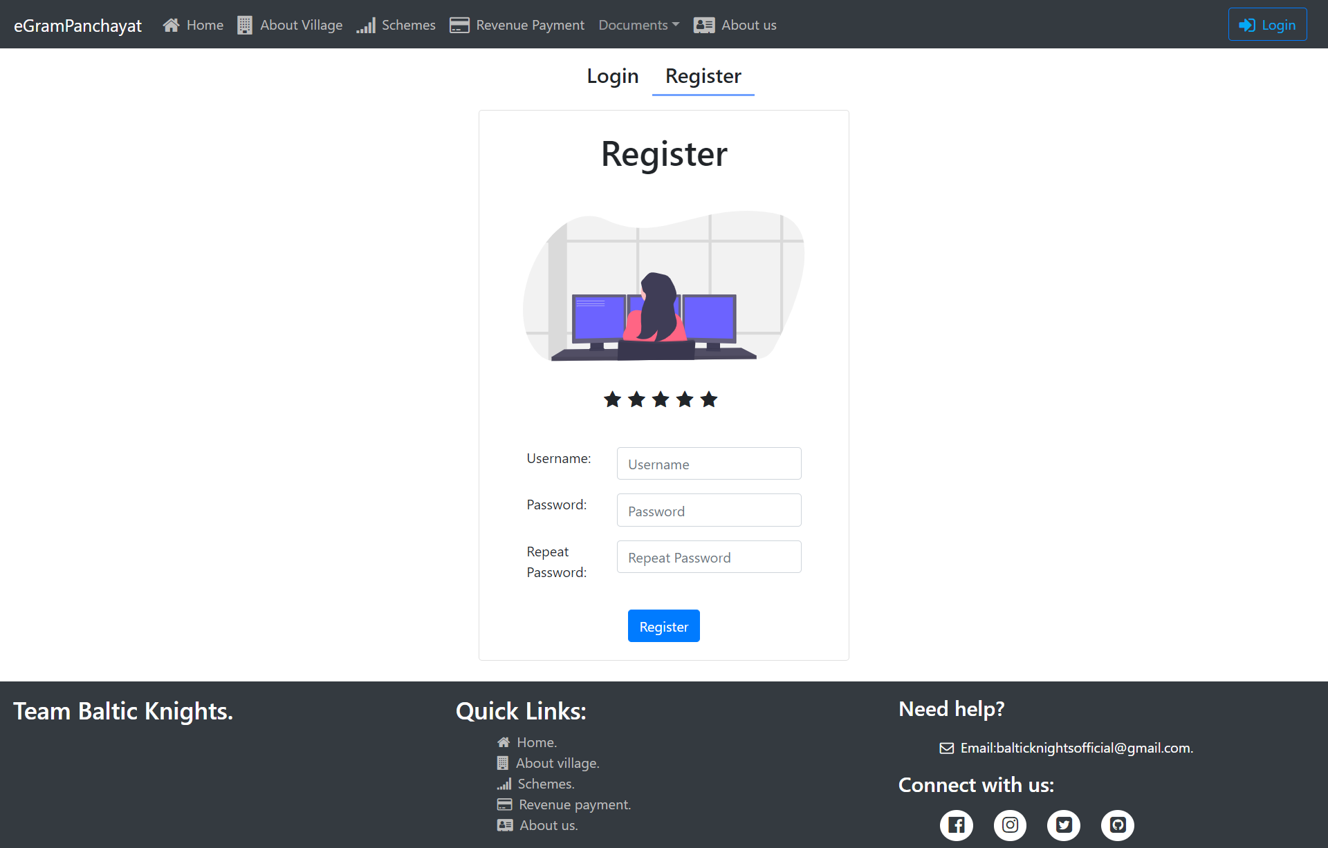
Prototype (Register) developed in React JS

Slide 14
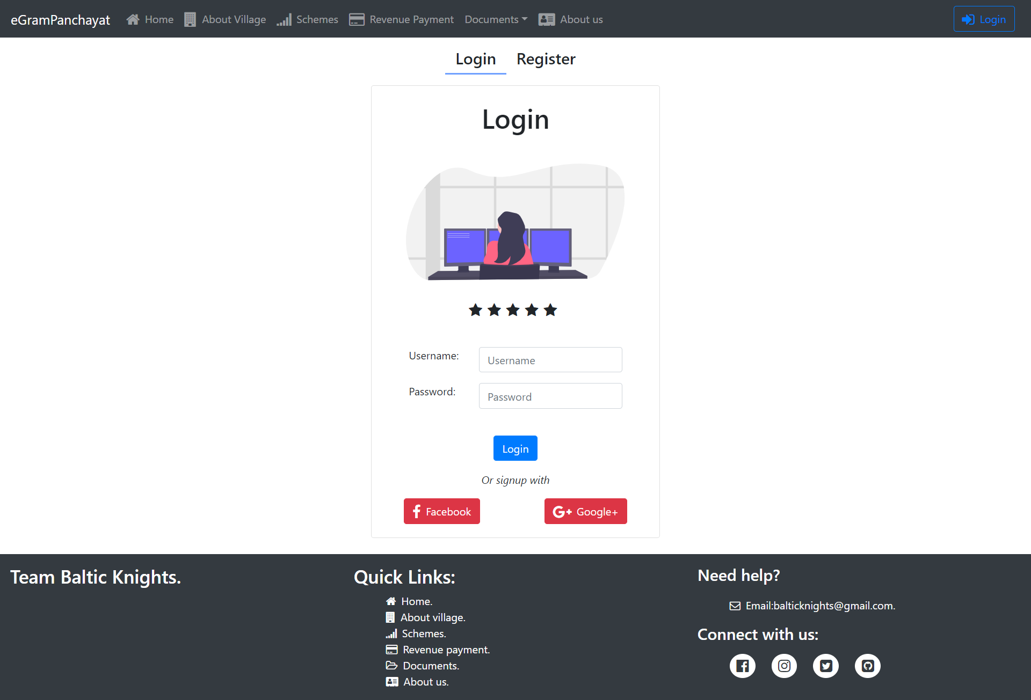
(continued) Prototype (Login)

Slide 15
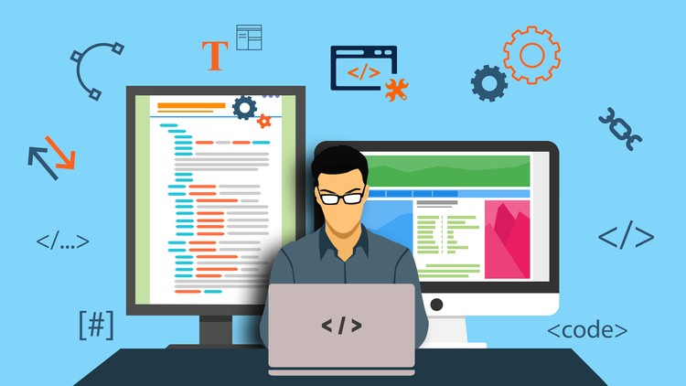
Technology stack
Modelling and Designs - Figma
Frontend - React,Reactstrap,Javascript,HTML,CSS, JSX
Server-side - Node JS , Express JS.
Backend - MongoDB Atlas

Slide 16
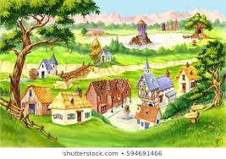
Benefits
Gram Panchayat staff will easily manage records without any paperwork (Paperless Work).
The Needy will be benefited with the schemes,as there will be no middlemen and hence no corruption. The schemes can be directly viewed from site
Villagers can concentrate on farming and their duties , as time will be saved of visiting the gram Panchayat.
The Central Government can direct keep in touch with the lowest level of democracy.

Slide 17


THANK YOU
Team - Baltic Knights
Vijay(TECOC308)
Govind(TECOC332)
Rohit(TECOC339)
Mehul(TECOC331)

